Slide 1
Unit 2
Communication Interface

Slide 2
Attendance 29-01-2025
Absent no.-
6,7,10,18,24,35,44,57,64,67,73,

Slide 3
Attendance 30-01-2025
Absent no.-
4,7,12,16,29,33,35,36,41,49,54,55,56,67,72,

Slide 4
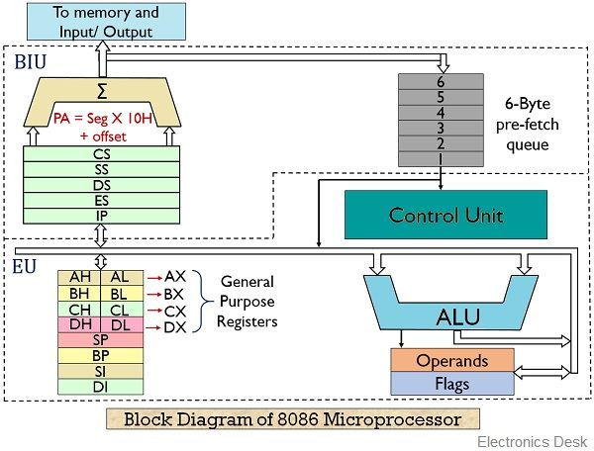
8086 Microprocessor
Notes:
The internal architecture of Intel 8086 is divided into 2 units: The Bus Interface Unit (BIU), and The Execution Unit (EU).

Slide 5
The Bus Interface Unit (BIU):
It provides the interface of 8086 to external memory and I/O devices via the System Bus. It performs various machine cycles such as memory read, I/O read, etc. to transfer data between memory and I/O devices.
BIU performs the following functions are as follows:
It generates the 20-bit physical address for memory access.
It fetches instructions from the memory.
It transfers data to and from the memory and I/O.
Maintains the 6-byte pre-fetch instruction queue(supports pipelining).

Slide 6
4 Segment registers

Slide 7
4 Segment registers
The instruction pointer
It is a 16-bit register. It holds offset of the next instructions in the Code Segment.
IP is incremented after every instruction byte is fetched.
IP gets a new value whenever a branch instruction occurs.
CS is multiplied by 10H to give the 20-bit physical address of the Code Segment.
The address of the next instruction is calculated by using the formula CS x 10H + IP.

Slide 8
4 Segment registers
The instruction pointer
A pre-fetch queue
It is a 6-byte queue (FIFO).
Fetching the next instruction (by BIU from CS) while executing the current instruction is called pipelining.
Gets flushed whenever a branch instruction occurs.
The pre-Fetch queue is of 6-Bytes only because the maximum size of instruction that can have in 8086 is 6 bytes. Hence to cover up all operands and data fields of maximum size instruction in 8086 Microprocessor there is a Pre-Fetch queue is 6 Bytes.
The pre-Fetch queue is connected with the control unit which is responsible for decoding op-code and operands and telling the execution unit what to do with the help of timing and control signals.

Slide 9
4 Segment registers
The instruction pointer
A pre-fetch queue
An Address Generation Circuit.
The BIU has a Physical Address Generation Circuit.
It generates the 20-bit physical address using Segment and Offset addresses using the formula:
In Bus Interface Unit (BIU) the circuit shown by the Σ symbol is responsible for the calculation unit which is used to calculate the physical address of an instruction in memory.
Physical Address = Segment Address x 10H + Offset Address

Slide 10
4 Segment registers
The instruction pointer
A pre-fetch queue
An Address Generation Circuit.
Code Segment register
(16 Bit register): CS holds the base address for the Code Segment. All programs are stored in the Code Segment and accessed via the IP.

Slide 11
4 Segment registers
The instruction pointer
A pre-fetch queue
An Address Generation Circuit.
Code Segment register
Data Segment register
(16 Bit register): DS holds the base address for the Data Segment.

Slide 12
4 Segment registers
The instruction pointer
A pre-fetch queue
An Address Generation Circuit.
Code Segment register
Data Segment register
Stack Segment register
(16 Bit register): SS holds the base address for the Stack Segment.

Slide 13
4 Segment registers
The instruction pointer
A pre-fetch queue
An Address Generation Circuit.
Code Segment register
Data Segment register
Stack Segment register
Extra Segment register
(16 Bit register): ES holds the base address for the Extra Segment.
Segments are present in memory and segment registers are present in Microprocessor. Segment registers store starting address of each segments in memory.

Slide 14
The main components of the EU are
General purpose registers,
the ALU,
Special purpose registers,
the Instruction Register and Instruction Decoder,
and the Flag/Status Register.
Fetches instructions from the Queue in BIU, decodes, and executes arithmetic and logic operations using the ALU.
Sends control signals for internal data transfer operations within the microprocessor.(Control Unit)
Sends request signals to the BIU to access the external module.
It operates with respect to T-states (clock cycles) and not machine cycles.

Slide 15
Features of 8086
The most prominent features of a 8086 microprocessor are as follows −
It has an instruction queue, which is capable of storing six instruction bytes from the memory resulting in faster processing.
It was the first 16-bit processor having 16-bit ALU, 16-bit registers, internal data bus, and 16-bit external data bus resulting in faster processing.
It is available in 3 versions based on the frequency of operation −
8086 → 5MHz
8086-2 → 8MHz
8086-1 → 10 MHz
It uses two stages of pipelining, i.e. Fetch Stage and Execute Stage, which improves performance.
Fetch stage can prefetch up to 6 bytes of instructions and stores them in the queue.
Execute stage executes these instructions. It has 256 vectored interrupts. It consists of 29,000 transistors.

Slide 16
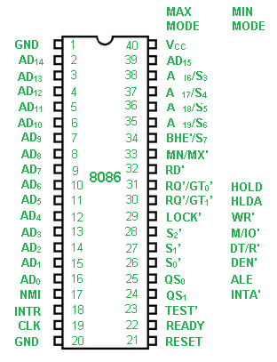
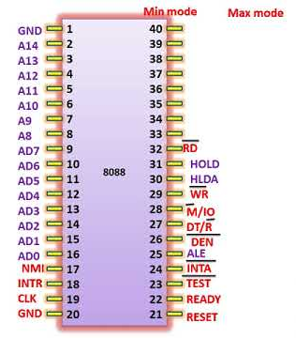
Notes:
Minimum mode and maximum mode are two configurations of the 8086 microprocessor. In minimum mode, the 8086 has a single processor that controls all signals. In maximum mode, the 8086 has multiple processors, and a bus controller chip generates control signals.
Minimum mode
A single 8086 processor controls all signals
The CPU generates all control signals
The MN/MX# input pin is set to logic 1
Maximum mode
Multiple processors can be used
A bus controller chip generates control signals
The MN/MX# input pin is set to logic 0
Status signals from the CPU determine control signals
How to select a mode
To select minimum mode, set the MN/MX# input pin to logic 1
To select maximum mode, set the MN/MX# input pin to logic 0

Slide 17
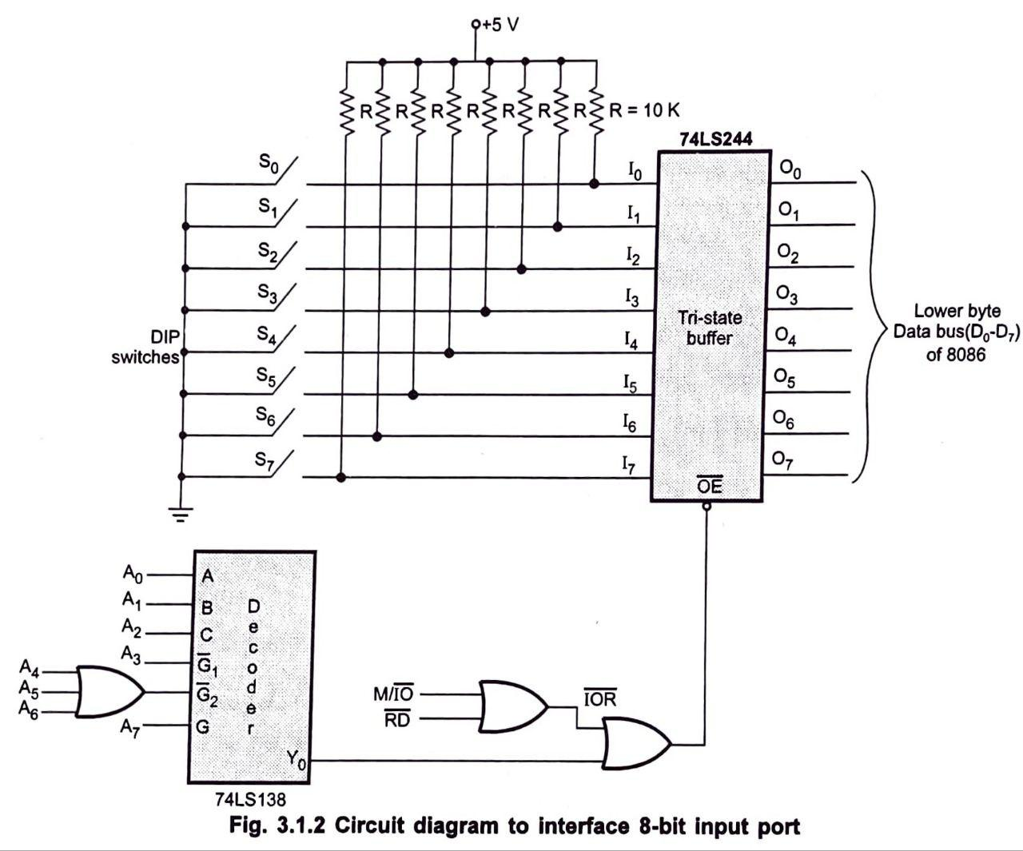
Interfacing 8 bit input Port
Notes:
A tri-state buffer is a logic gate that has three stable output states: high, low, and high impedance. It's used to connect multiple devices to a single bus line, allowing them to take turns transmitting data.
How it works
A tri-state buffer has a data input and a control input.
When the control input is high, the buffer acts like a normal buffer, passing the input to the output.
When the control input is low, the buffer enters a high impedance state, disconnecting its output from the bus.
This allows other devices to use the bus without interference.
A decoder is a digital circuit that converts binary code into a specific output signal. Decoders are used in many fields, including computer systems, data transmission, and communication equipment.
How it works
A decoder receives binary code as input.
The decoder performs a decoding operation.
The decoder outputs a specific signal that the device can process.

Slide 18
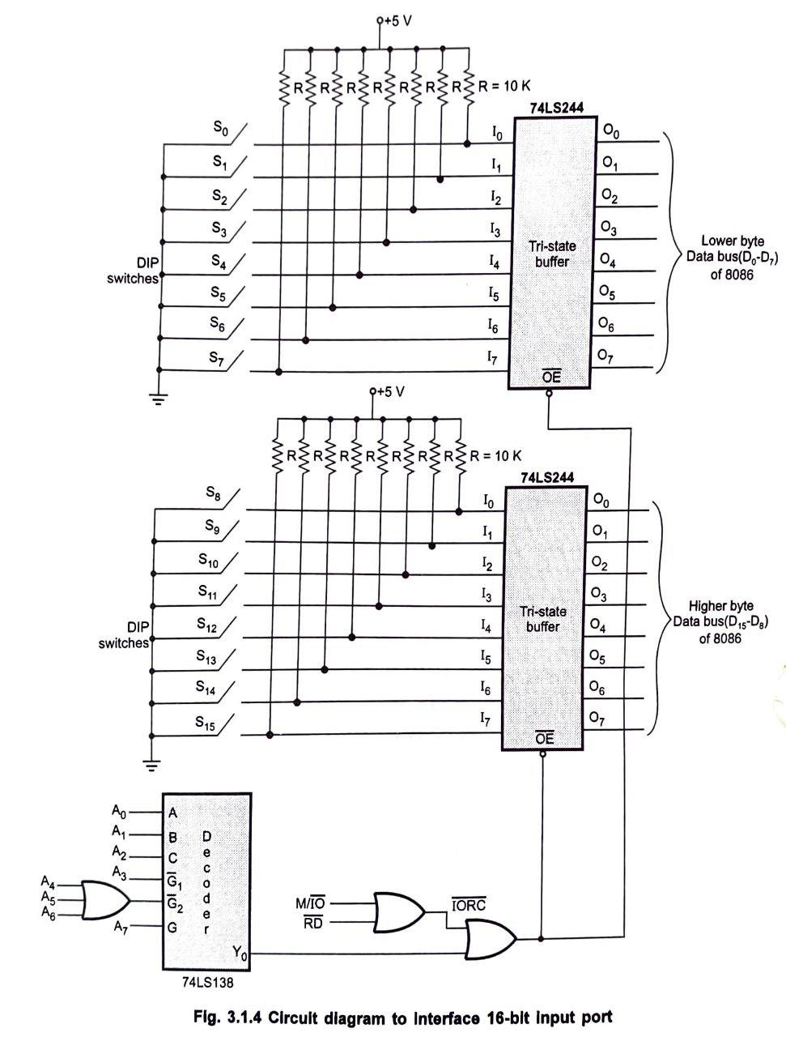
Interfacing 16 bit input Port

Slide 19
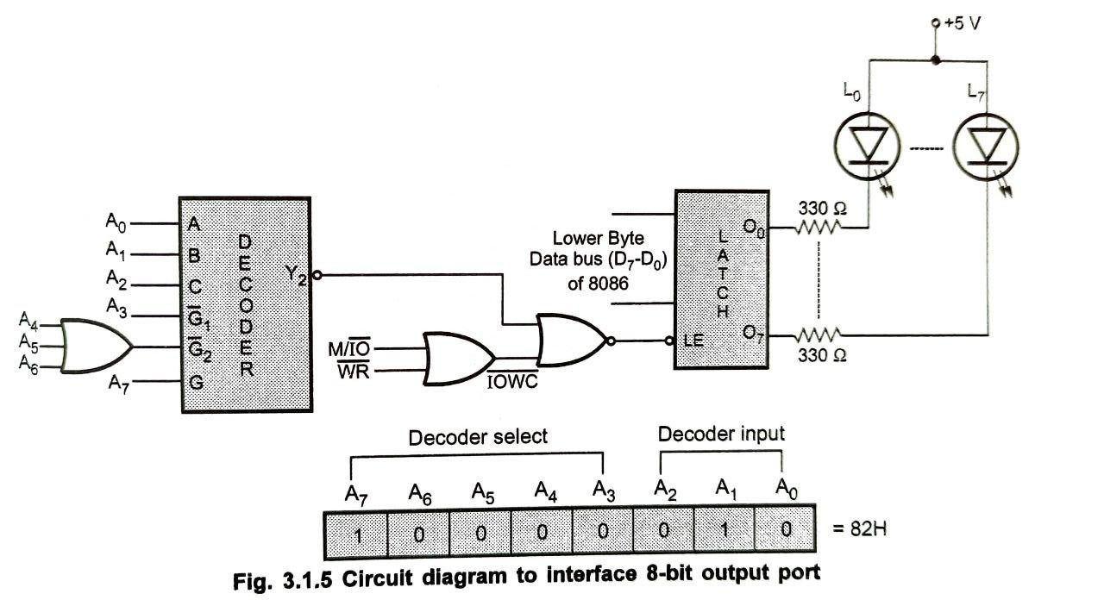
Interfacing 8 bit output Port

Slide 20
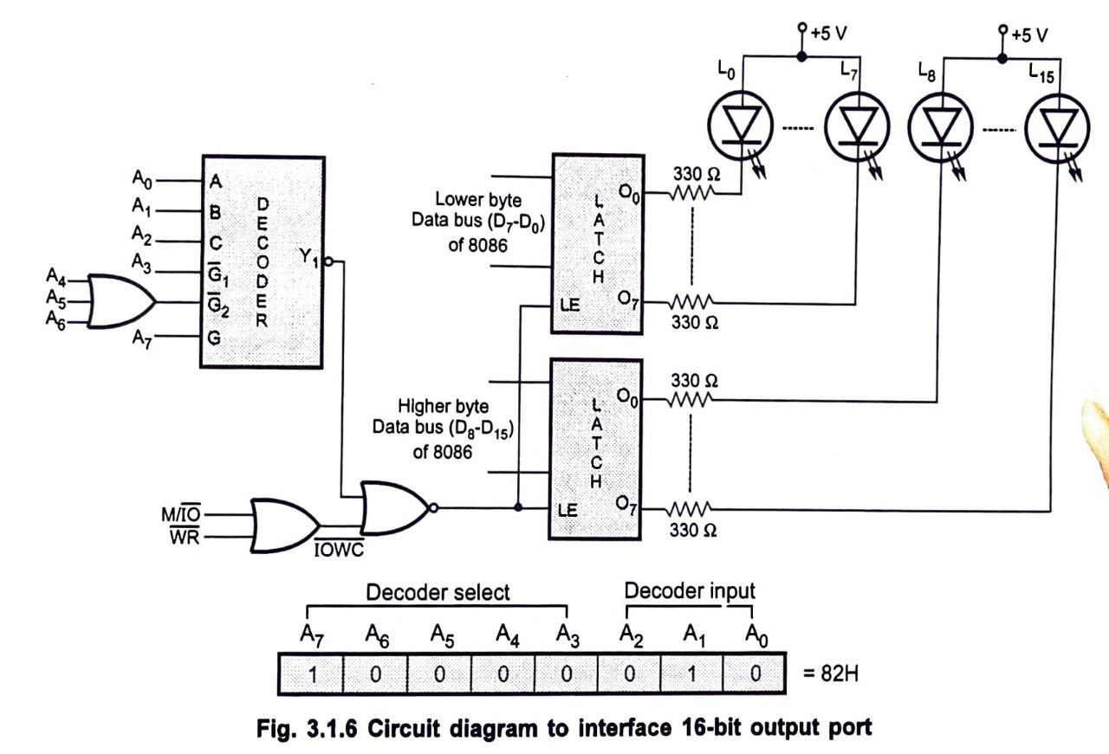
Interfacing 16 bit output Port

Slide 21
Basic Peripherals & their interfacing with 8086/8088

Slide 22
Basic Peripherals & their interfacing with 8086/8088
Interfacing basic peripherals with the 8086/8088 microprocessors is a fundamental aspect of system design in embedded systems and computer architecture.
The 8086 and 8088 are 16-bit microprocessors, and they can interface with various peripherals such as keyboards, displays, printers, and storage devices.

Slide 23
Overview of some common peripherals and their interfacing methods with the 8086/8088 microprocessors.

Slide 24
Keyboard Interfacing
Keyboard Interface: The keyboard can be interfaced using a matrix arrangement or a direct connection. The most common method is to use a keyboard controller like the 8042.
Connection: The keyboard controller is connected to the data bus and control lines of the 8086/8088.
Operation: The keyboard sends a scan code to the microprocessor when a key is pressed. The microprocessor reads the scan code from the keyboard controller.
Interrupts: The keyboard controller can generate an interrupt (IRQ1) to signal the microprocessor that a key has been pressed.

Slide 25
Display Interfacing
LED Display: A simple LED display can be interfaced using a port connected to the data bus.
Connection: Connect the LED display to one of the I/O ports of the 8086/8088.
Operation: The microprocessor sends data to the port, which lights up the corresponding LEDs.
LCD Display: An LCD can be interfaced using a controller like the HD44780.
Connection: The LCD controller is connected to the data bus and control lines.
Operation: The microprocessor sends commands and data to the LCD controller to display characters.

Slide 26
Printer Interfacing
Parallel Printer Interface: Printers are commonly interfaced using a parallel port (e.g., Centronics interface).
Connection: The printer is connected to the data bus and control lines (e.g., STROBE, ACK).
Operation: The microprocessor sends data to the printer through the data lines. Control signals are used to manage the printing process.
Serial Printer Interface: Serial printers can be interfaced using a UART (Universal Asynchronous Receiver-Transmitter).
Connection: The UART is connected to the data bus and control lines.
Operation: The microprocessor sends data serially to the printer through the UART.

Slide 27
Storage Device Interfacing
Floppy Disk Drive (FDD): The floppy disk drive can be interfaced using a disk controller.
Connection: The disk controller is connected to the data bus and control lines.
Operation: The microprocessor sends commands to the disk controller to read from or write to the floppy disk.
Hard Disk Drive (HDD): Similar to the floppy disk, a hard disk drive is interfaced using a disk controller (e.g., IDE controller).
Connection: The IDE controller is connected to the data bus and control lines.
Operation: The microprocessor communicates with the IDE controller to manage data storage and retrieval.

Slide 28
Analog-to-Digital Converter (ADC)
ADC Interfacing: An ADC can be used to convert analog signals to digital data.
Connection: The ADC is connected to the data bus and control lines.
Operation: The microprocessor sends a signal to the ADC to start the conversion, and then it reads the digital output from the ADC.

Slide 29
Digital-to-Analog Converter (DAC)
DAC Interfacing: A DAC can be used to convert digital data to analog signals.
Connection: The DAC is connected to the data bus.
Operation: The microprocessor sends digital data to the DAC, which converts it to an analog signal.

Slide 30
Timer/Counter Interfacing
Programmable Interval Timer (PIT): A timer can be used for generating time delays or counting events.
Connection: The PIT is connected to the data bus and control lines.
Operation: The microprocessor can program the timer to generate interrupts at specified intervals.

Slide 31
Interfacing peripherals with the 8086/8088 microprocessors involves connecting the peripherals to the data bus, address bus, and control lines, and writing software routines to manage communication.
Each peripheral has its own specific requirements and protocols, but the general principles of interfacing remain consistent. Understanding these concepts is crucial for designing effective microprocessor-based systems.

Slide 32
Semiconductor Memory Interfacing

Slide 33
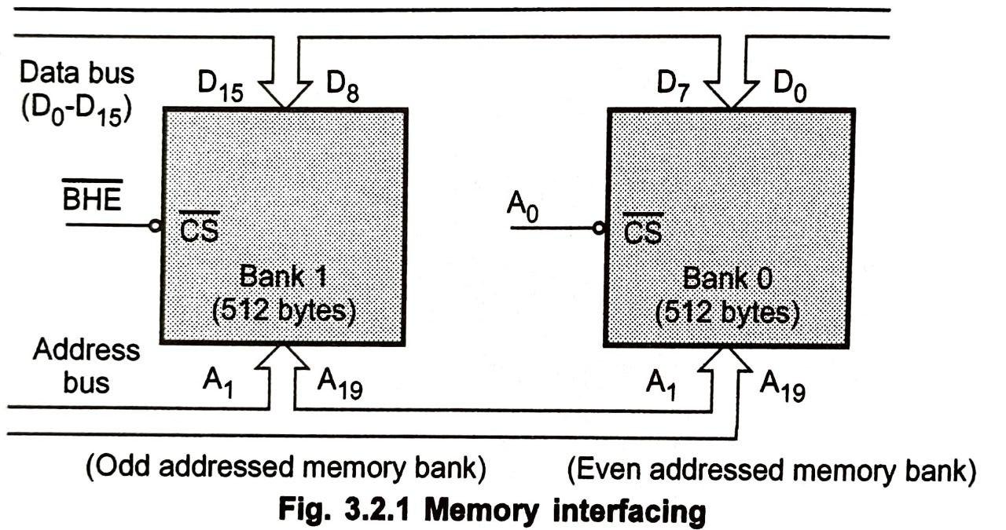

Slide 34
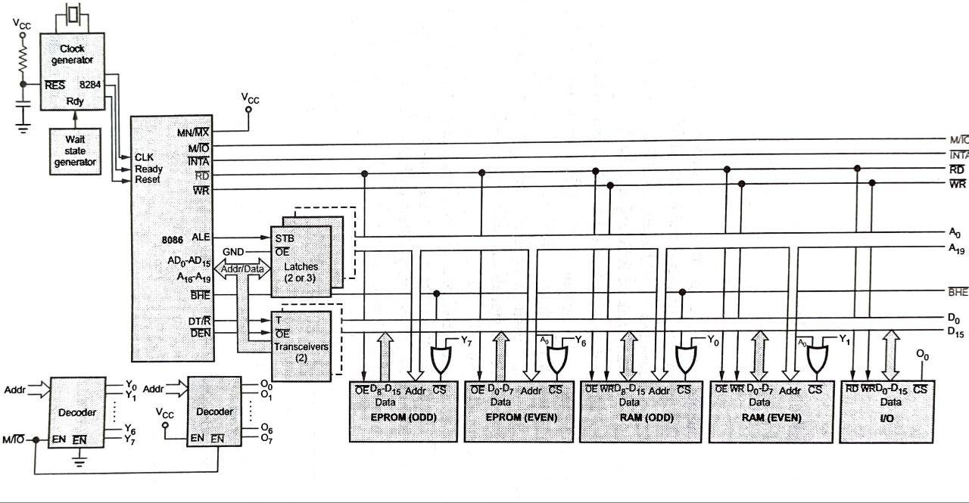
Minimum Mode 8086 System

Slide 35
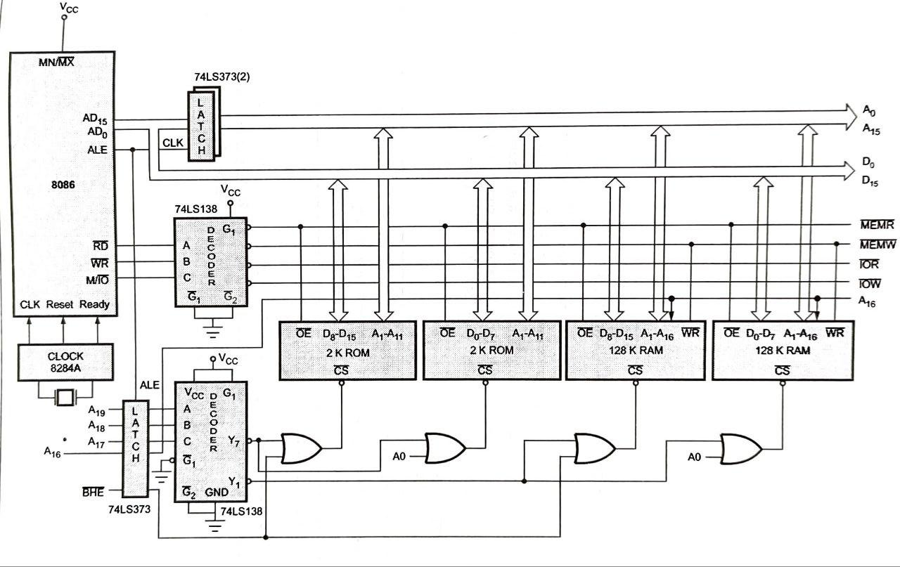
Interfacing 128K RAM & 2K ROM with 8086 in Minimum Mode

Slide 36
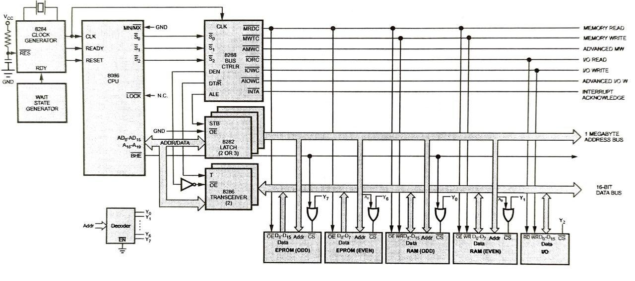
Interfacing Memory with 8086 in Minimum Mode

Slide 37
Dynamic RAM (DRAM) Interfacing
Dynamic RAM (DRAM) is a type of memory that stores each bit of data in a separate capacitor within an integrated circuit. Because capacitors leak charge, DRAM must be refreshed periodically to maintain the data. Interfacing DRAM involves several key components:
Address Lines: These lines are used to select the memory location. The number of address lines determines the maximum memory capacity (e.g., 2^n locations for n address lines).
Data Lines: These lines are used to read from and write to the memory. The width of the data bus (e.g., 8-bit, 16-bit) determines how much data can be transferred at once.
Control Signals: These include signals like Row Address Strobe (RAS), Column Address Strobe (CAS), and Write Enable (WE). RAS and CAS are used to select the row and column of the memory cell, while WE indicates whether data is being written to or read from the memory.
Refresh Logic: Since DRAM needs to be refreshed, additional circuitry is often required to periodically refresh the memory cells.

Slide 38
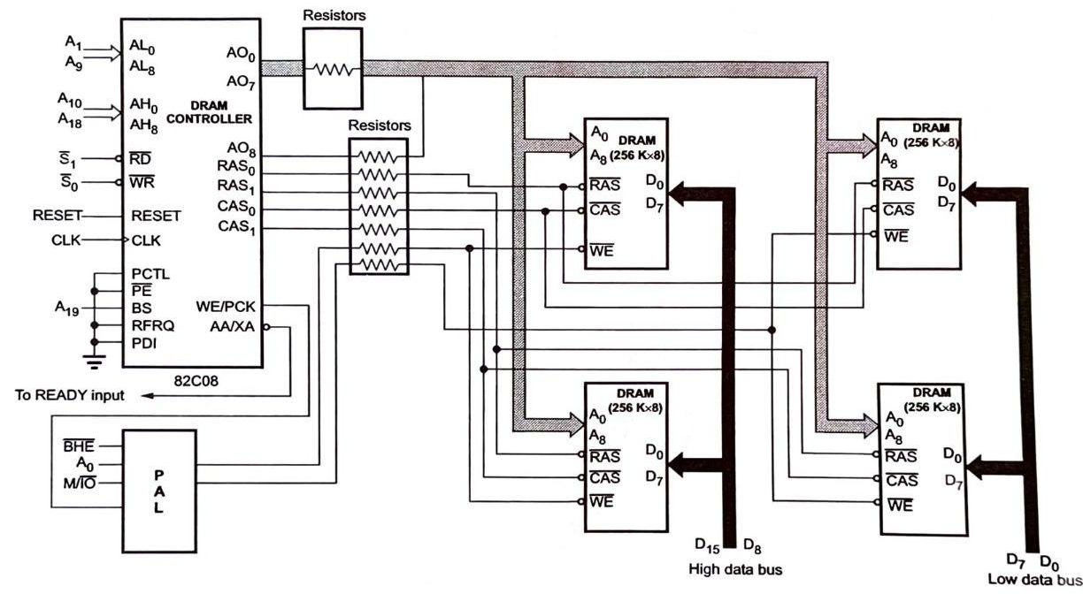
DRAM Interfacing

Slide 39
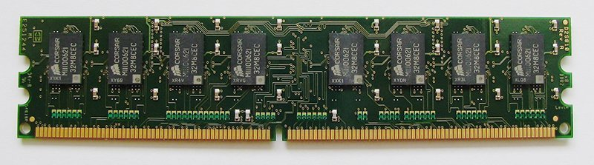
DRAM

Slide 40
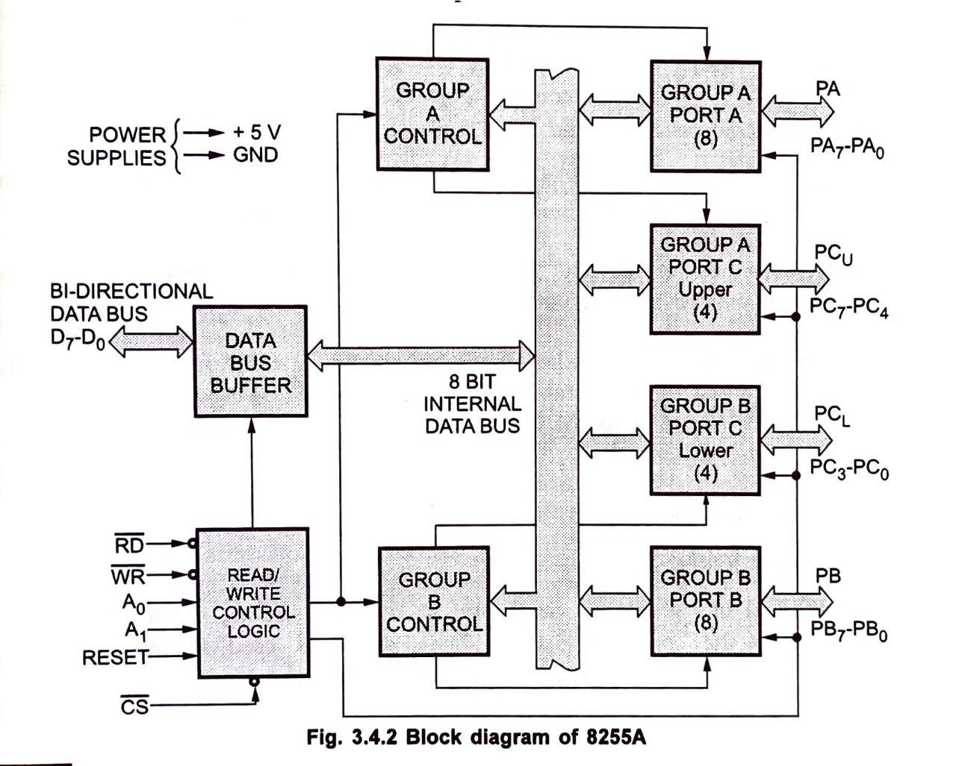
PIO 8255

Slide 41





PIO 8255
Group A
PORT A
Group A
Control
$${PA}_{7} − {PA}_{0}$$
Data Bus Control
Buffer
Group A
PORT C
UPPER
$$D_{7} − D_{0}$$
$${PC}_{7} − {PC}_{4}$$
24 I/O lines
8/16 bit higher capability microprocessor
2 groups A and B each 12 I/O lines
Again subdivided into each 8I/O lines
Control Word Registers
Read Write Control Logic
Internal Line
Works together (4+4=8 bit)
Group B
PORT C
LOWER
$${PC}_{3} − {PC}_{0}$$
RD
WR
A0
A1
Reset
Read
Write
Control
Logic
Group B Control
Group B
PORT B
$${PB}_{7} − {PB}_{0}$$
CS

Slide 42
Ports of 8255
8255 has three ports, i.e., PORT A, PORT B, and PORT C.
Port A contains one 8-bit output latch/buffer and one 8-bit input buffer.
Port B is similar to PORT A.
Port C can be split into two parts, i.e. PORT C lower (PC0-PC3) and PORT C upper (PC7-PC4) by the control word.
These three ports are further divided into two groups, i.e. Group A includes PORT A and upper PORT C. Group B includes PORT B and lower PORT C. These two groups can be programmed in three different modes, i.e. the first mode is named as mode 0, the second mode is named as Mode 1 and the third mode is named as Mode 2.

Slide 43
Operating Modes
8255 has three different operating modes −
Mode 0 − In this mode, Port A and B is used as two 8-bit ports and Port C as two 4-bit ports. Each port can be programmed in either input mode or output mode where outputs are latched and inputs are not latched. Ports do not have interrupt capability.
Mode 1 − In this mode, Port A and B is used as 8-bit I/O ports. They can be configured as either input or output ports. Each port uses three lines from port C as handshake signals. Inputs and outputs are latched.
Mode 2 − In this mode, Port A can be configured as the bidirectional port and Port B either in Mode 0 or Mode 1. Port A uses five signals from Port C as handshake signals for data transfer. The remaining three signals from Port C can be used either as simple I/O or as handshake for port B.

Slide 44
Interfacing I/O Ports - PIO 8255
The 8255 Programmable Peripheral Interface (PPI) is a widely used I/O port interface that allows microprocessors to communicate with peripheral devices. It provides a flexible way to interface with various I/O devices. The 8255 can be configured in different modes:
Mode 0 (Basic Input/Output): In this mode, the ports can be used for simple input and output operations. Each port can be configured as either input or output.
Mode 1 (Strobed Input/Output): This mode allows for handshaking between the microprocessor and peripheral devices. It is useful for devices that require synchronization.
Mode 2 (Bidirectional Bus): This mode allows for bidirectional data transfer on a single port, which is useful for interfacing with devices like printers.

Slide 46
Key Features of 8255
Three 8-bit Ports: The 8255 has three 8-bit ports (Port A, Port B, and Port C) that can be configured independently.
Control Word Register: This register is used to configure the operation of the 8255, including setting the mode of operation for each port.
Interrupt Capability: The 8255 can generate interrupts, allowing the microprocessor to respond to events from peripheral devices.
Address/data bus must be externally demux'd.
It is TTL compatible.
It has improved DC driving capability.

Slide 47
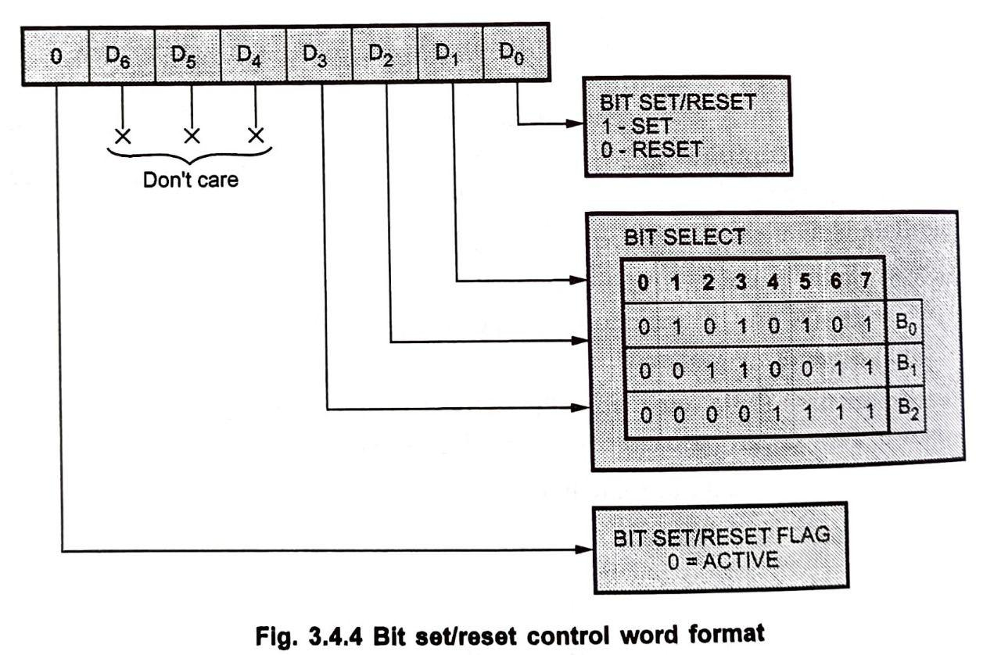
Control Word Format- For Bit/Reset Mode

Slide 48
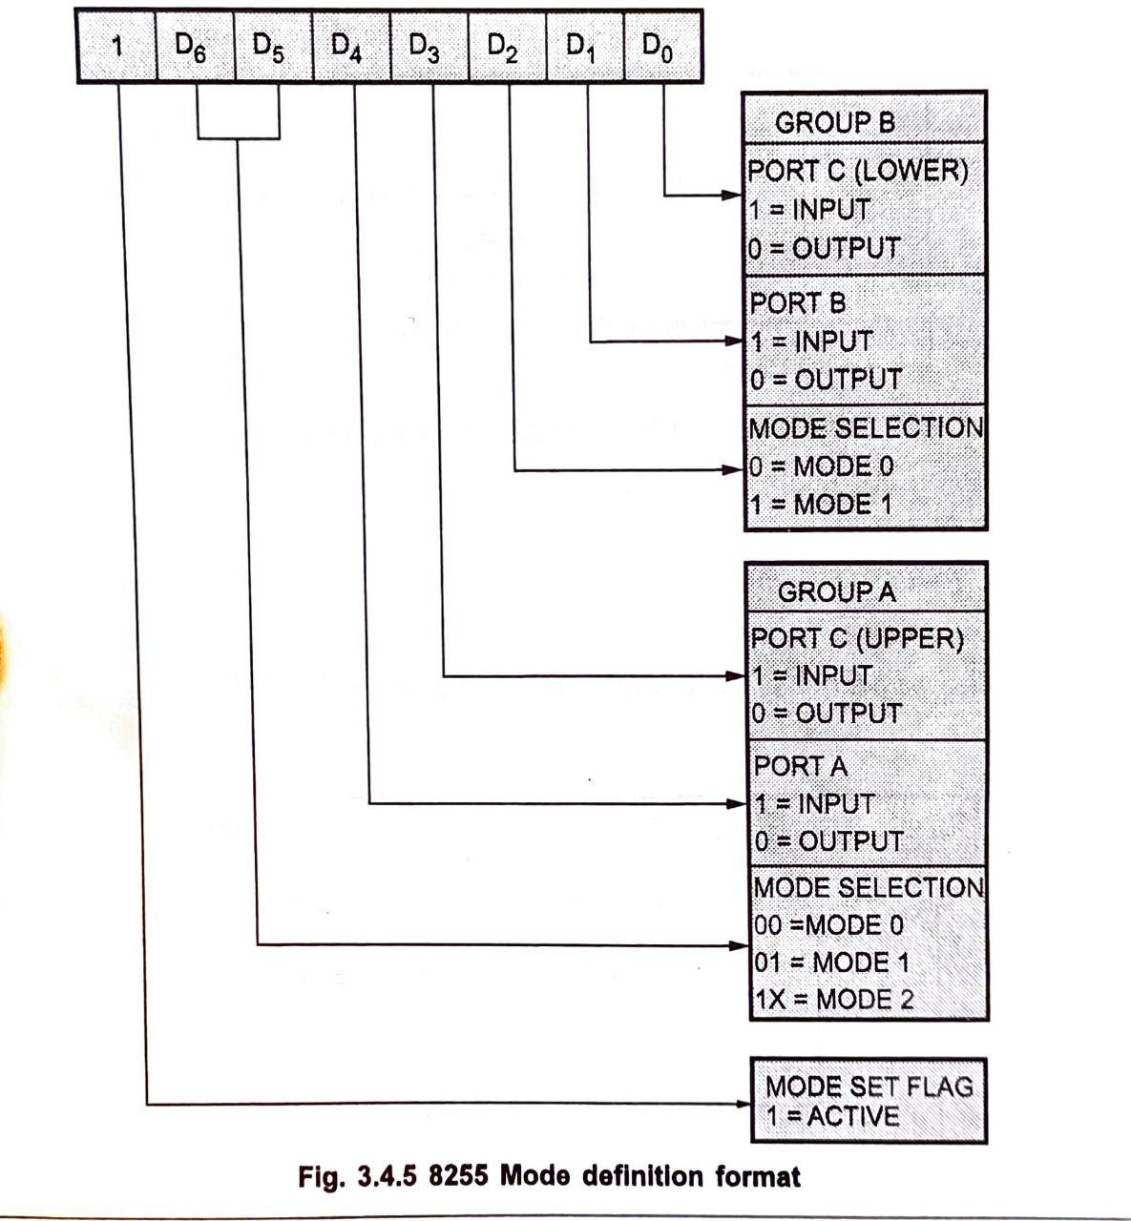
Control Word Format- For I/O Mode

Slide 49
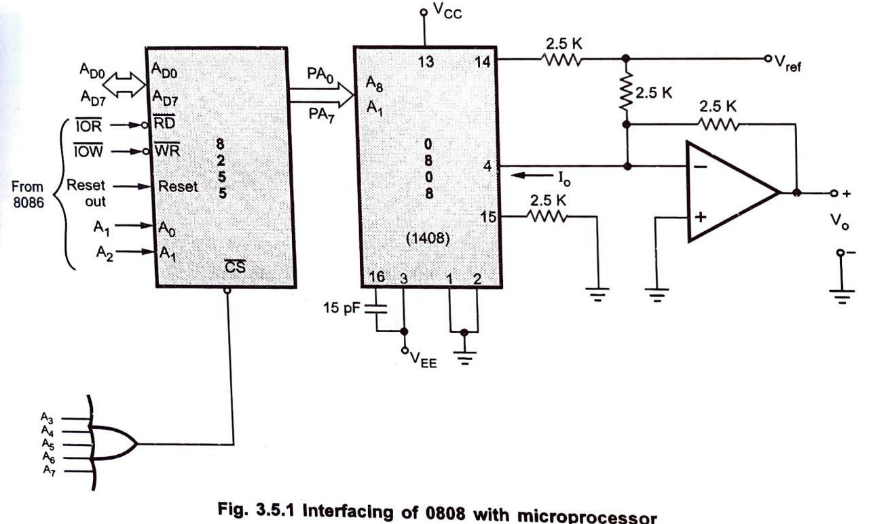
Interfacing DAC

Slide 50
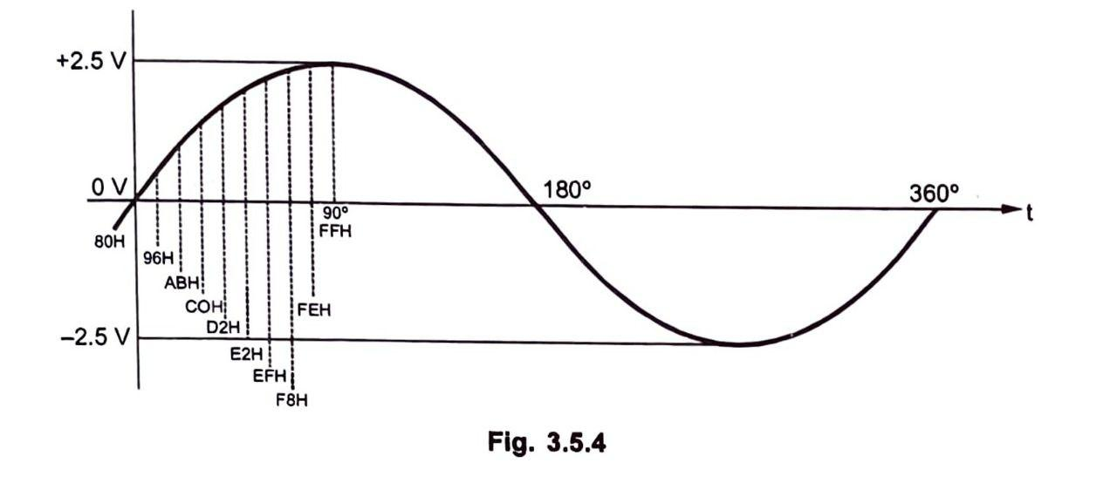

Slide 51
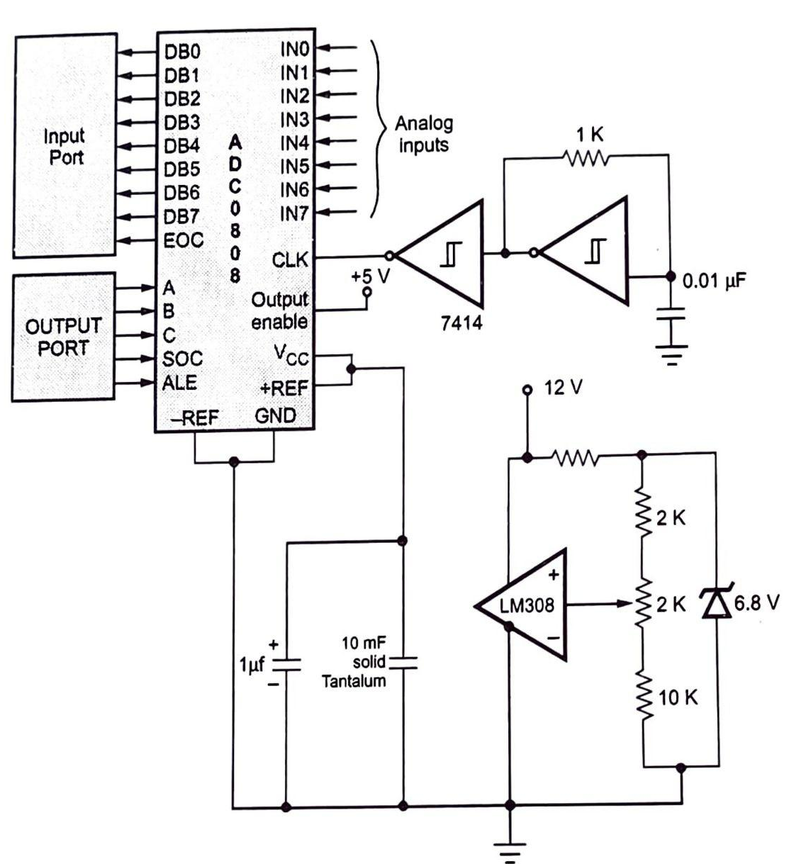
Interfacing ADC

Slide 52
Interfacing Example
To interface a microprocessor with DRAM and the 8255 PPI, the following steps are typically involved:
Connect the Address and Data Lines: Connect the address lines of the microprocessor to the address lines of the DRAM and the data lines to the data bus.
Control Signals: Connect the control signals (RAS, CAS, WE) to the appropriate pins on the DRAM.
Connect the 8255: Connect the data and control lines of the 8255 to the microprocessor. Configure the 8255 using the control word register to set the desired mode for the ports.
Programming: Write the necessary software routines to read from and write to the DRAM and to communicate with peripheral devices through the 8255.

Slide 53
Interfacing of Stepper Motor

Slide 54
Stepper Motor
A stepper motor, also known as step motor or stepping motor, is a brushless DC electric motor that converts digital pulses into mechanical shaft rotation incrementally (around 1.8 degrees for a typical stepper) rather than continuously rotating as DC motors do.
The stepper motor works on the principle of electromagnetic induction, where a rotating magnetic field is used to turn the motor's shaft incrementally.
It is one of the most commonly used motion control components in industrial systems due to its simplicity of operation, accuracy and smooth movement.

Slide 55
What Is Stepper Motor?
A stepper motor is essentially a synchronous motor that divides a full rotation into a number of equal steps (around 200 steps). It is an electromechanical device which converts digital pulses into mechanical shaft rotation.
Some key aspects of a stepper motor include:
It has a rotor with permanent magnets and a stator that contains winding. The winding is divided into phases (often two or more).
Each step is caused by the energizing of the motor's stator winding in a particular sequence. The rotor aligns itself to the nearest stator pole.
Step angle is defined as the angular rotation produced per pulse applied to the motor. A typical step angle is 1.8 degrees.
Speed and distance covered by the motor are directly proportional to the rate at which pulses are applied.
They are available in different NEMA frame sizes denoted by their frame diameter in inches like NEMA 17, 23, 24 etc.
Stepper motors can hold their position without power, which makes them suitable for open-loop control applications like CNC machines.

Slide 56
Working Principle Of Stepper Motor
The basic working principle of a stepper motor can be explained as follows:
It consists of a stator (stationary outer cylinder) and a rotor (inner cylinder attached to the shaft).
The stator contains electromagnets which are organized into groups known as "phases". The most common types have two or four phases.
The rotor contains permanent magnets or pole pieces. It is attached to the motor shaft which extends outside for connection to a device.
When one phase is energized, it rotates the rotor slightly in one direction. As soon as the first phase is energized, the second one is powered to continue the motion.
Repeating the process of energizing the phases in sequence causes the rotor to rotate in steps.
By controlling the sequence of energizing the electromagnets, the direction of rotation can be controlled.
Varying the number of steps per pulse gives finer position resolution. Higher number of steps per pulse means smaller angular rotation per step.

Slide 57
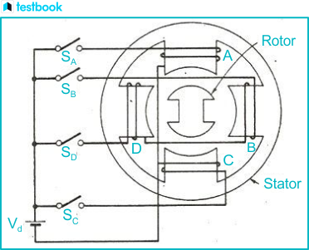
A stepper motor converts digital pulses into mechanical rotation incrementally by energizing its electromagnetic stator coils in a sequence. This makes it suitable for open-loop precision motion control applications.

Slide 58

Step Angle in Stepper Motor
Step angle is defined as the angular rotation produced by the stepper motor per pulse given as input. A standard step angle varies between 1.8° to 0.9°. Smaller the step angle, better the positional accuracy and higher the number of steps per revolution.
Common step angles of 1.8° gives a resolution of 200 steps/revolution while 0.9° gives 400 steps/revolution. Microstepping techniques can produce step angles less than 1° for high precision applications.

Slide 59
Step Angle
The number of steps required to complete one full rotation depends on the step angle of the stepper motor. The step angle can vary from 0.72 degrees to 15 degrees per step. Depending on that 500 to 24 steps may be required to complete one rotation. In position control applications the selection on motor should be based on the minimum degree of rotation that is required per step.

Slide 60
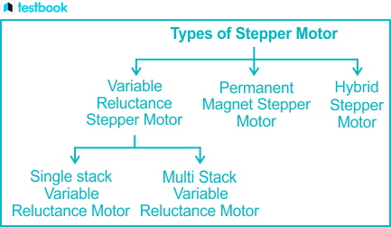
Types

Slide 61
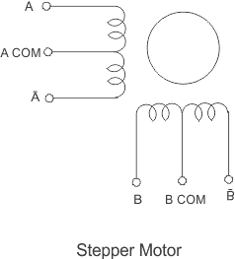
Stepper Motor
A stepper motor is a type of DC motor that moves in precise steps. The rotation speed depends on the rate of electrical signals applied, and the direction of rotation is controlled by the pattern of pulses.
A stepper motor is made up of a rotor, which is normally a permanent magnet and it is, as the name suggests the rotating component of the motor. A stator is another part which is in the form of winding.
In the diagram, the center is the rotor which is surrounded by the stator winding. This is called as four phase winding.

Slide 62
Stepping Sequence
In order to get correct motion of the motor, a stepping sequence has to be followed. This stepping sequence gives the voltage that must be applied to the stator phase. Normally a 4 step sequence is followed.
When the sequence is followed from step 1 to 4, we get a clock wise rotation and when it is followed from step 4 to 1, we get a counter clockwise rotation.

Slide 63
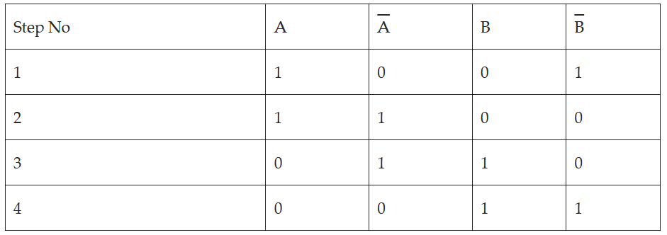
Stepping Sqequence

Slide 64
Half Stepping
Stepper motors can operate at half the actual step angle, known as half stepping. For example, a motor rated for 15 degrees per step can be programmed to rotate at 7.5 degrees per step using a special half-stepping sequence.

Slide 65
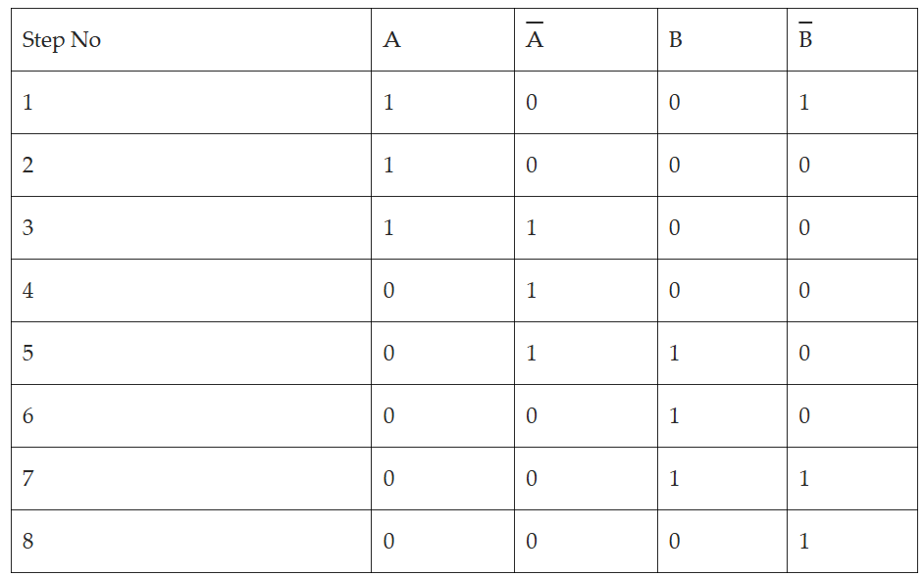
Half Stepping Sequence

Slide 66
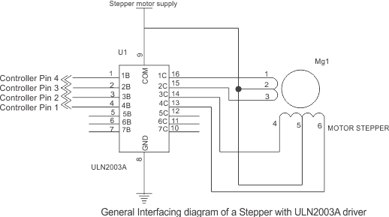
Interfacing Diagram
Notes:
The diagram below shows the interfacing of stepper motor to a micro-controller. This is general diagram and can be applied to any micro-controller family like PIC micro-controller, AVR or 8051 micro-controller.
Since the microcontroller cannot provide enough current, a driver like ULN2003 is used to run the motor. Individual transistors or other driver ICs can also be used. Ensure external pull-up resistors are connected if needed. Never connect the motor directly to the controller pins. The motor voltage depends on its size. A typical 4 phase uni-polar stepper motor has 5 terminals. 4 phase terminals and one common terminal of the center tap that is connected to ground.

Slide 67
